Slide 1
Commands
Ranks
Settings
˅
x
User
Kick
Ban
Add User
Remove User
Rank

Slide 2
Commands
Ranks
Settings
˅
x
Ranks
Commands
Permission
Users
Noclip
T-Mod
Noclip
0000 0000 0000 041F
Moderator
Is Admin
Allows players to use the Noclip command.
Is Superadmin
Administrator
Physgun Player Pickup Allow
Manager
Owner
Add
Copy
Remove

Slide 3
Commands
Ranks
Settings
˅
x

Slide 4
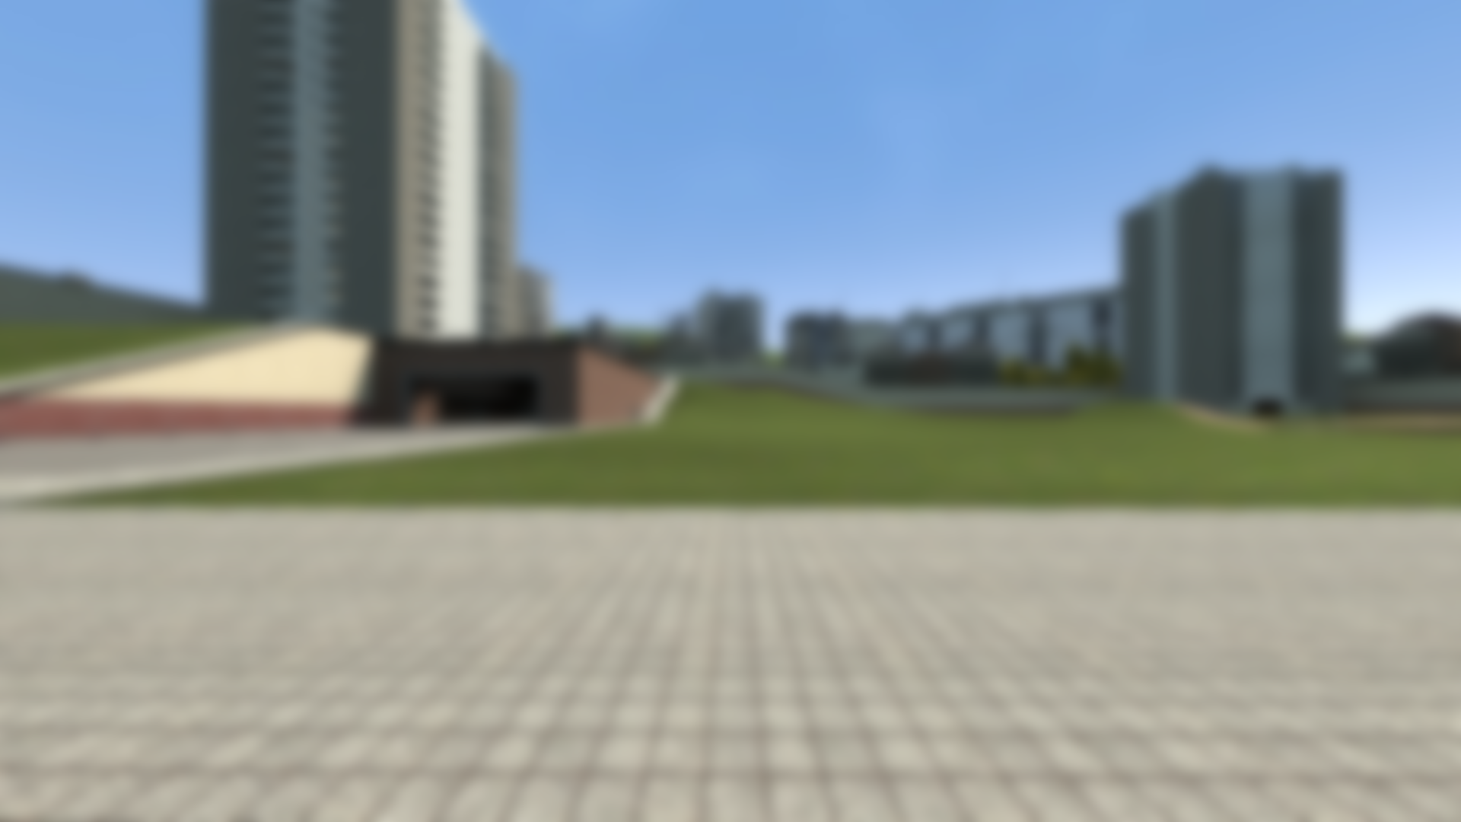
JAAS
Just Another Admin System

Slide 5
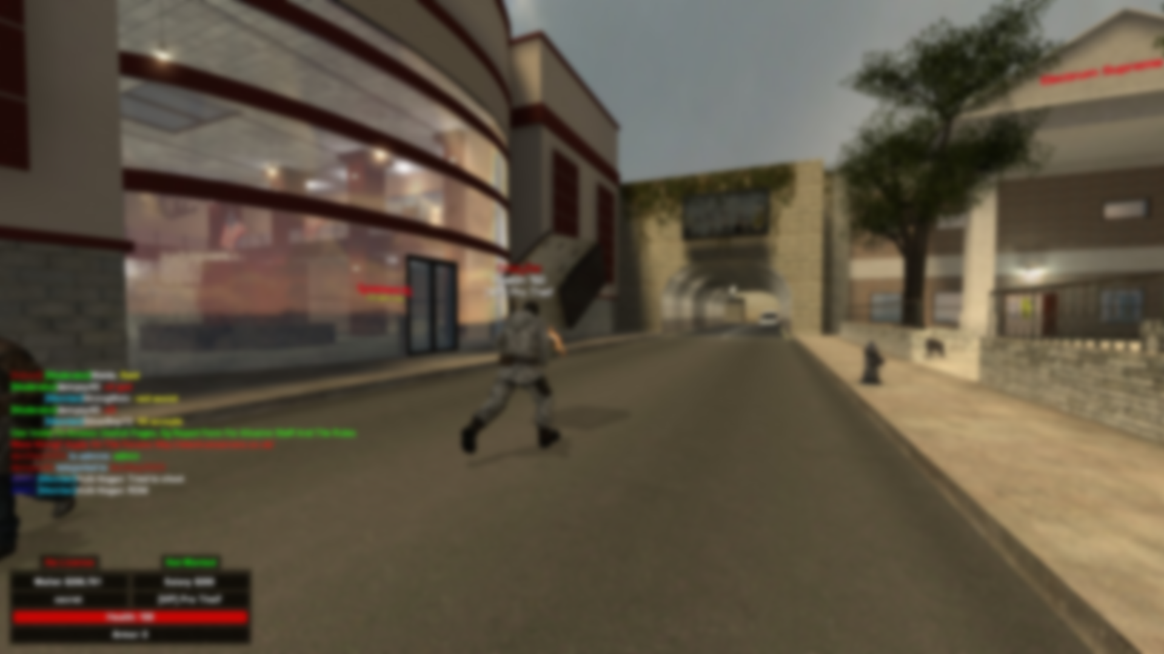
Commands
Commands
Favourites
Favourites
Toggle Noclip
Commands
Toggle Noclip
Add
Add
User
User
Add
Add
Ranks
Remove
Rank
Rank
Moderator
Add
Admin
Remove
Access
Player
Remove Ranks
secret_survivor
Set Power
Dempsy
Get Ranks
Logs
Execute
Utility
Rank
Player is required to execute
Toggle Flight
Moderator
Toggle Gravity Flight
Settings
Admin
Remove
Toggle Noclip
Rank
Player
Add
secret_survivor
Remove
Dempsy
Remove Ranks
Execute
Set Power
Get Ranks

Slide 6
Ranks
Commands
Permissions
Users
Dempsy
User
Moderator
Noclip
Commands
0000 0000 0001 1F43
Add
0000 0000 0000 0001
0000 0000 0001 1F43
secret_survivor
0000 0000 0001 1F43
Admin
Pickup
0000 0000 0001 1F43
Remove
0000 0000 0000 0002
0000 0000 0000 0000
0000 0000 0001 1F43
Power
0
Can Edit Variables
Utility
Invisible
0000 0000 0001 1F43
Ranks
Toggle Flight
✓
Physgun Player Pickup Allow
0000 0000 0001 1F43
Superadmin
0000 0000 0001 1F43
Toggle Gravity Flight
0000 0000 0000 0004
Can Player Taunt
0000 0000 0001 1F43
Owner
0000 0000 0001 1F43
Toggle Noclip
0000 0000 0000 0008
Can Player Spray
Access
0000 0000 0001 1F43
0000 0000 0000 0000
Can Pickup Item
0000 0000 0000 0000
Can Pickup Weapon
0000 0000 0000 0000
Is Superadmin
Logs
0000 0000 0001 1F43
Is Admin
0000 0000 0001 1F43
Add
Remove
Settings
Name
Power
0
Invisible
✓
Add
Remove
Remove
Remove
Remove

Slide 7
Access Groups
Commands
Permissions
Ranks
Noclip
Moderator
Commands
1
0000 0000 0000 0001
Pickup
Admin
0
0000 0000 0000 0002
Can Edit Variables
Superadmin
2
0000 0000 0000 0004
Ranks
Physgun Player Pickup Allow
Owner
2
0000 0000 0000 0008
Can Player Taunt
1
Can Player Spray
Access
1
Can Pickup Item
1
Can Pickup Weapon
1
Is Superadmin
Logs
2
Is Admin
2
Settings
Superadmin Group
2
0000 0000 0000 000C
Mod Group
1
0000 0000 0000 0001
Add
Remove

Slide 8
56
57
58
59
00
01
02
03
04
06/07/2020
X
Command
Logs
:
00 : 00
Module
Players
Rank
Action
52 : addons/just-another-admin-system/lua/jaas/command_module.lua
Current Logs
[16:43] [Rank] Moderator was created
[16:43] [Game] secret_survivor was killed by Dempsy using AK-47
[16:43] [Command] secret_survivor has kicked Dempsy “RDM”
[16:43] [Rank] secret_survivor added Dempsy to Moderator
[16:44] [Game] Dempsy joined
1 : addons/just-another-admin-system/lua/jaas/jaas_rank_module.lua
Execution Logs
Commands
SQL
06/07/2020
751 : addons/just-another-admin-system/lua/jaas-core/jaas-module.lua
Ranks
Access
Logs
5 Days
Settings

Slide 9
Settings
Commands
Ranks
Access
Logs
Settings

